Slide 1


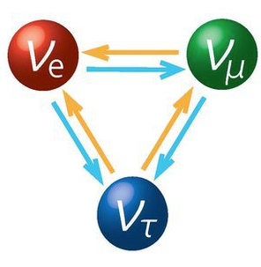
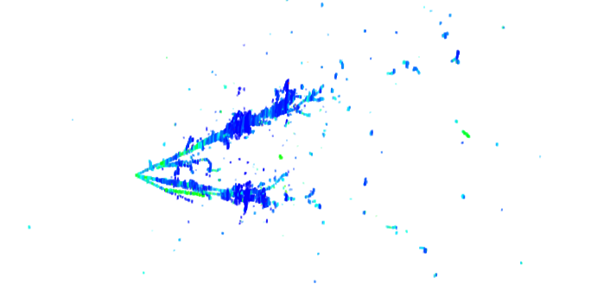

Development of LArTPCs for Neutrino Physics
Xin Qian
BNL
http://lar.bnl.gov/

Slide 2
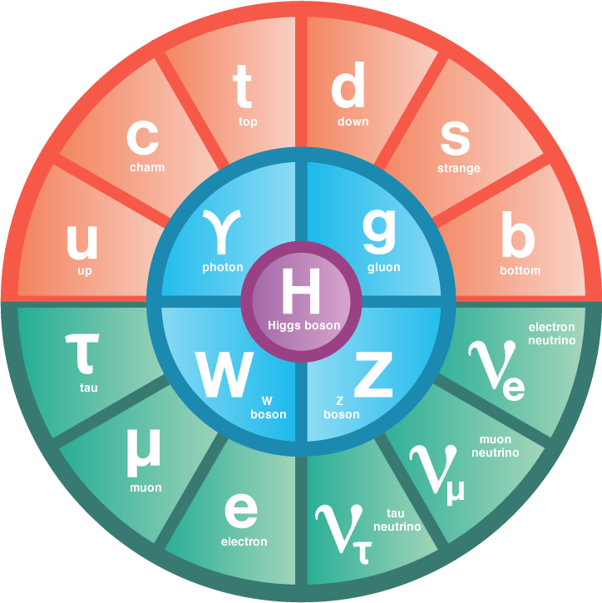
As fundamental particles in the standard model of particle physics, neutrinos are the second most abundant (known) particles in our universe
Notes:
For every proton/neutron/electron the Universe contains a billion of neutrinos from the Big Bang

Slide 3
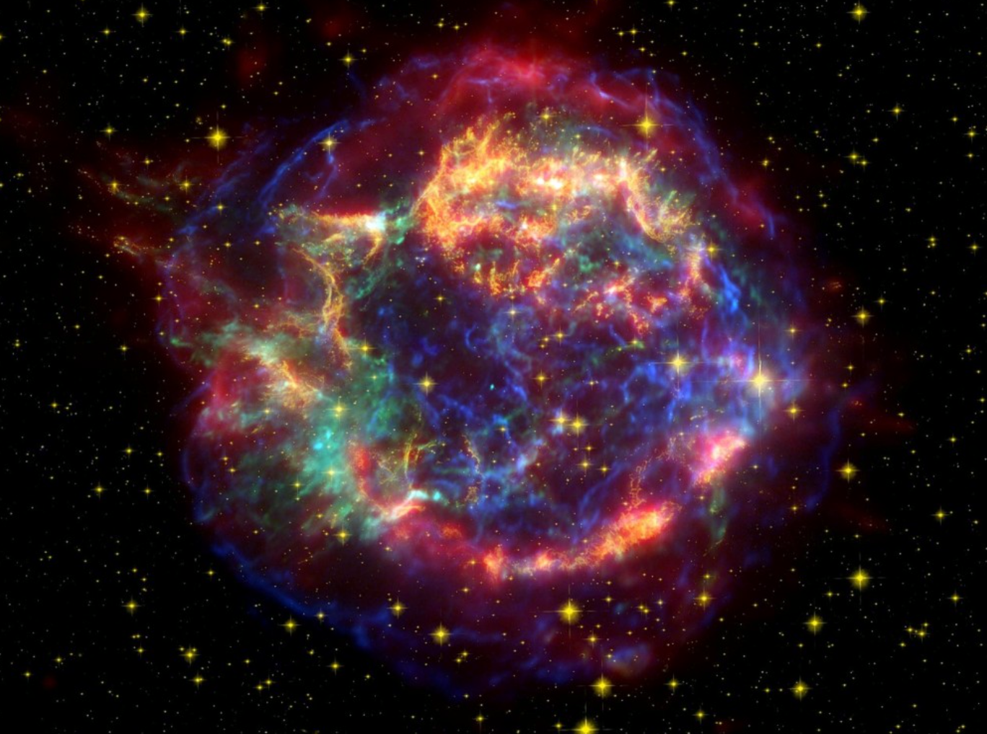
Neutrinos from the Universe
99% of the energy in a core collapse supernova explosion is carried away by neutrinos
10³⁸ ν_{e}/s are produced by the sun
Notes:
A mole of neutrino passing through your body through your lifetime

Slide 4
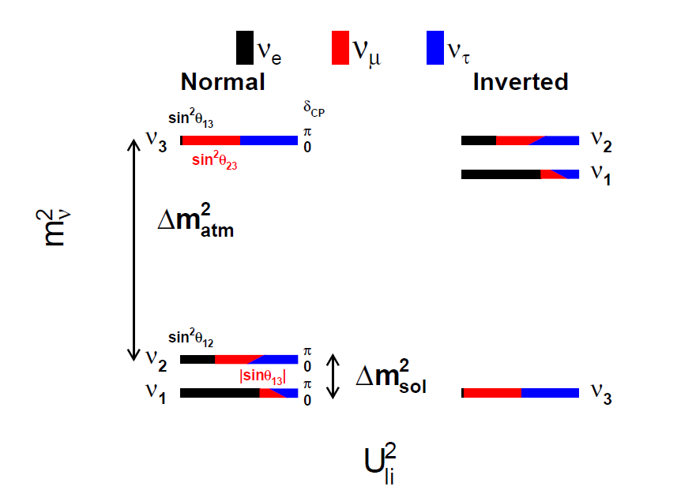
1973-2012-Now
1998-2012-Now
Non-zero neutrino mass and mixing is evidence of physics beyond the standard model
Notes:
Maximal violation of parity

Slide 5
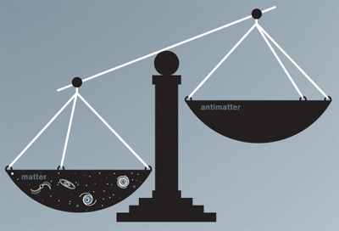
Big Questions in Neutrino Physics
Are neutrinos responsible for the large matter anti-matter asymmetry?

Slide 6
Big Questions in Neutrino Physics
Are neutrinos responsible for the large matter anti-matter asymmetry?
What’s the neutrino mass hierarchy?
Review of “Neutrino Mass Hierarchy”
XQ and P. Vogel, Prog. Part. Nucl. Phys. 83, 1

Slide 7
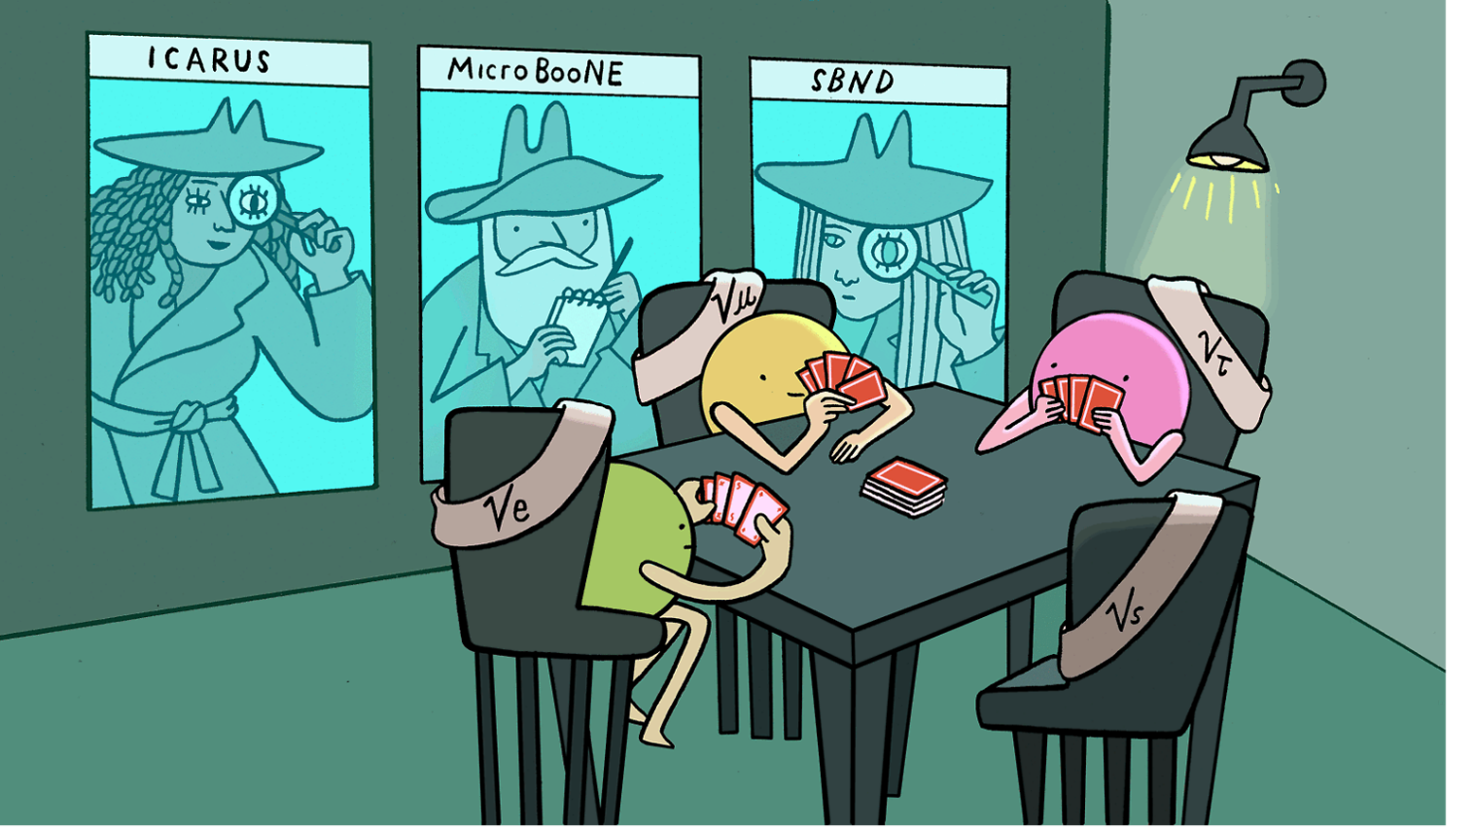
Big Questions in Neutrino Physics
Are neutrinos responsible for the large matter anti-matter asymmetry?
What’s the neutrino mass hierarchy?
Do sterile neutrinos exist?
Symmetry magazine

Slide 8
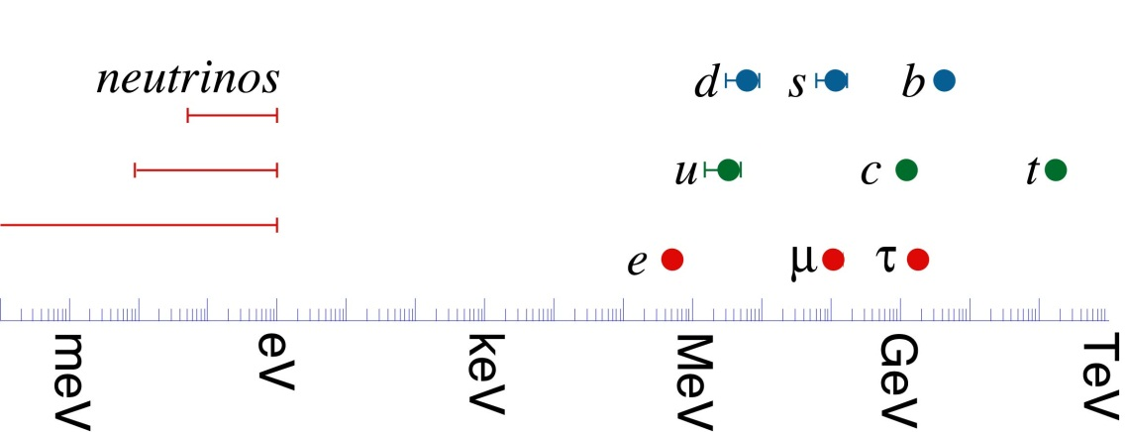
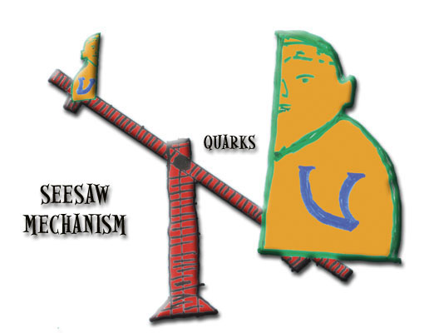
Big Questions in Neutrino Physics
Are neutrinos responsible for the large matter anti-matter asymmetry?
What’s the neutrino mass hierarchy?
Do sterile neutrinos exist?
Are neutrinos Dirac or Majorana particles?

Slide 9
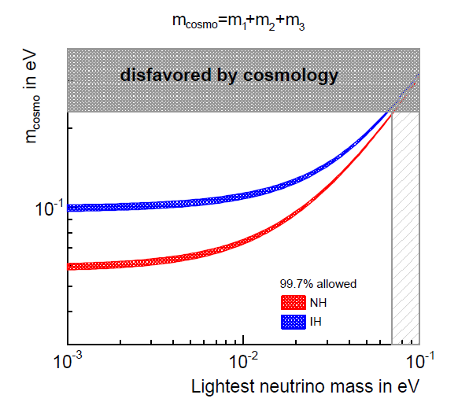
Big Questions in Neutrino Physics
Are neutrinos responsible for the large matter anti-matter asymmetry?
What’s the neutrino mass hierarchy?
Do sterile neutrinos exist?
Are neutrinos Dirac or Majorana particles?
What is the neutrino mass?
…

Slide 10
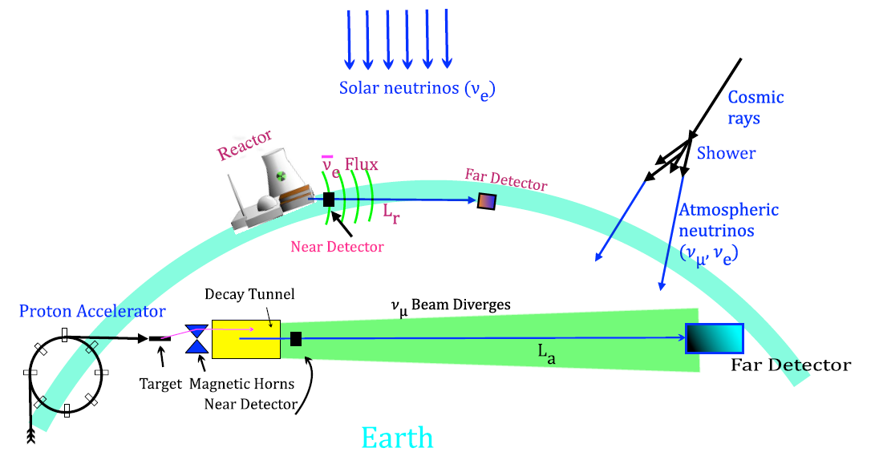
Big Questions in Neutrino Physics
Are neutrinos responsible for the large matter anti-matter asymmetry?
What’s the neutrino mass hierarchy?
Do sterile neutrinos exist?
Are neutrinos Dirac or Majorana particles?
What is the neutrino mass?
…
Precision neutrino oscillation measurements with man-made accelerator neutrinos are crucial to answer these questions
Review of “Long-Baseline Neutrino Experiments”, M. V. Diwan, V. Galymov, XQ, A. Rubbia, Annu. Rev. Nucl. Par. Sci. 66, 47

Slide 11
Liquid Argon Time Projection Chambers (LArTPCs) for neutrino physics

Slide 12
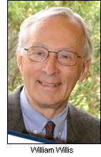
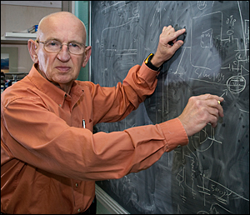
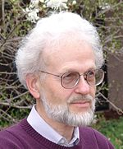

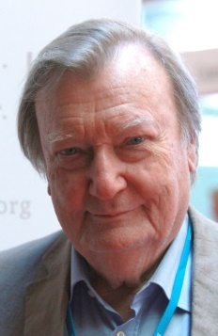
Early History of LArTPC Development
W. Willis and V. Radeka, Liquid argon ionization chambers as total absorption detector, NIMA 120:221 (1974)
D. R. Nygren, The Time Projection Chamber: A New 4π Detector for Charged Particles. eConf. C740805:58 (1974)
H. H. Chen et al. A Neutrino detector sensitive to rare process. I. A study of neutrino electron reactions. FNAL-Proposal-0496 (1976)
C. Rubbia, The liquid argon time projection chamber: a new concept for neutrino detector, CERN-EP/77-08 (1977)
V. Radeka
H. H. Chen
D. R. Nygren
C. Rubbia

Slide 13
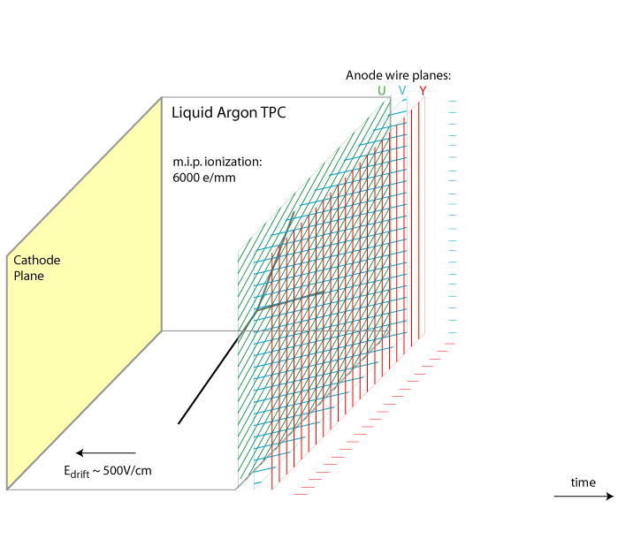
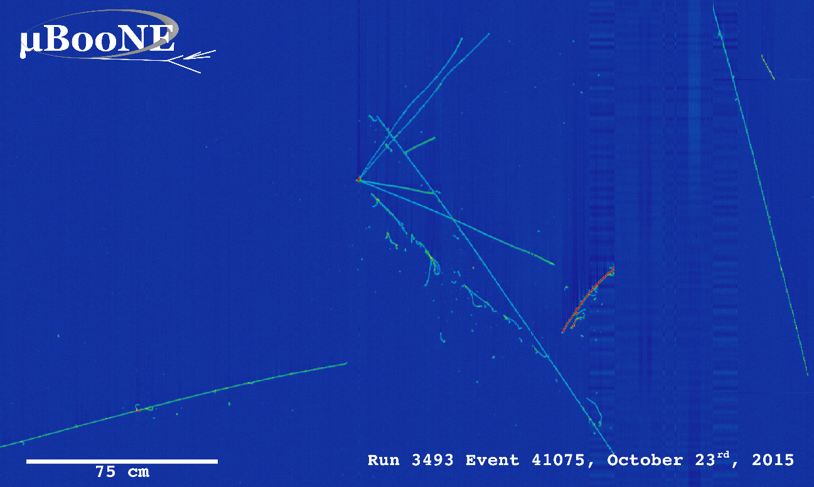
Principle of Single-Phase Liquid Argon Time Projection Chamber (LArTPC)
~mm scale position resolution with multiple 1D wire readouts
Particle identification (PID) with energy depositions and topologies
Made by Bo Yu (BNL)
time
Drift velocity 1.6 km/s → several ms drift time

Slide 14
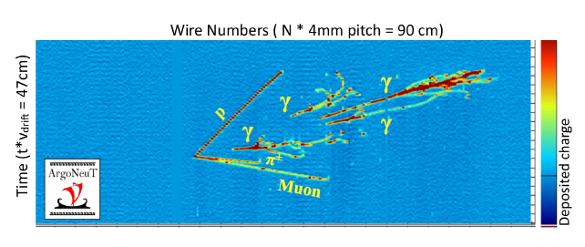
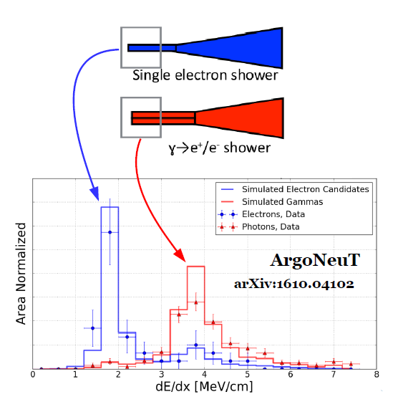
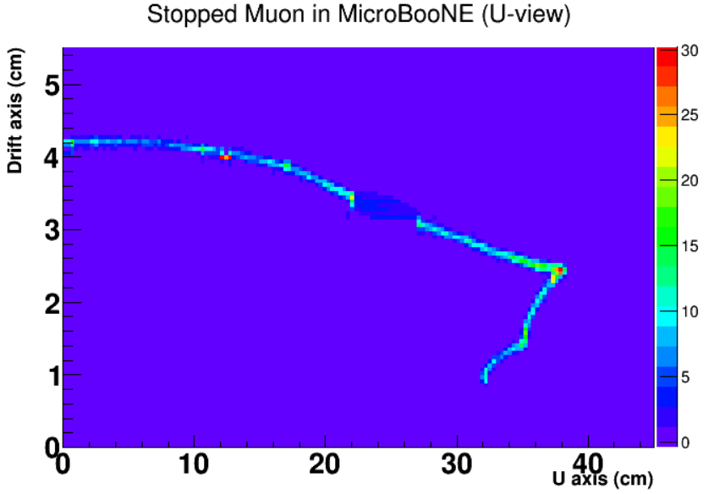
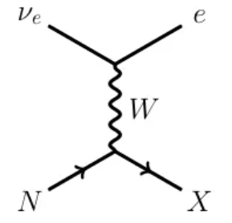
Unique capability to identify ν_{e} charge-current interactions in LArTPC
Comparison of P_{MCS} and P_{Range} to separate low-energy e/µ for ν_{e} charge-current interaction
Gap Identification + dE/dx to separate e/γ
Stopped muon
Dead ch.
Michel e

Slide 15
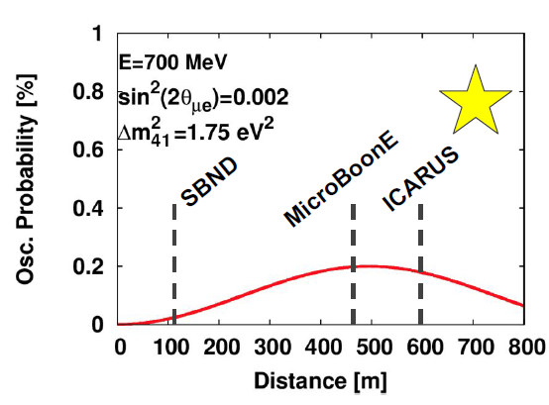
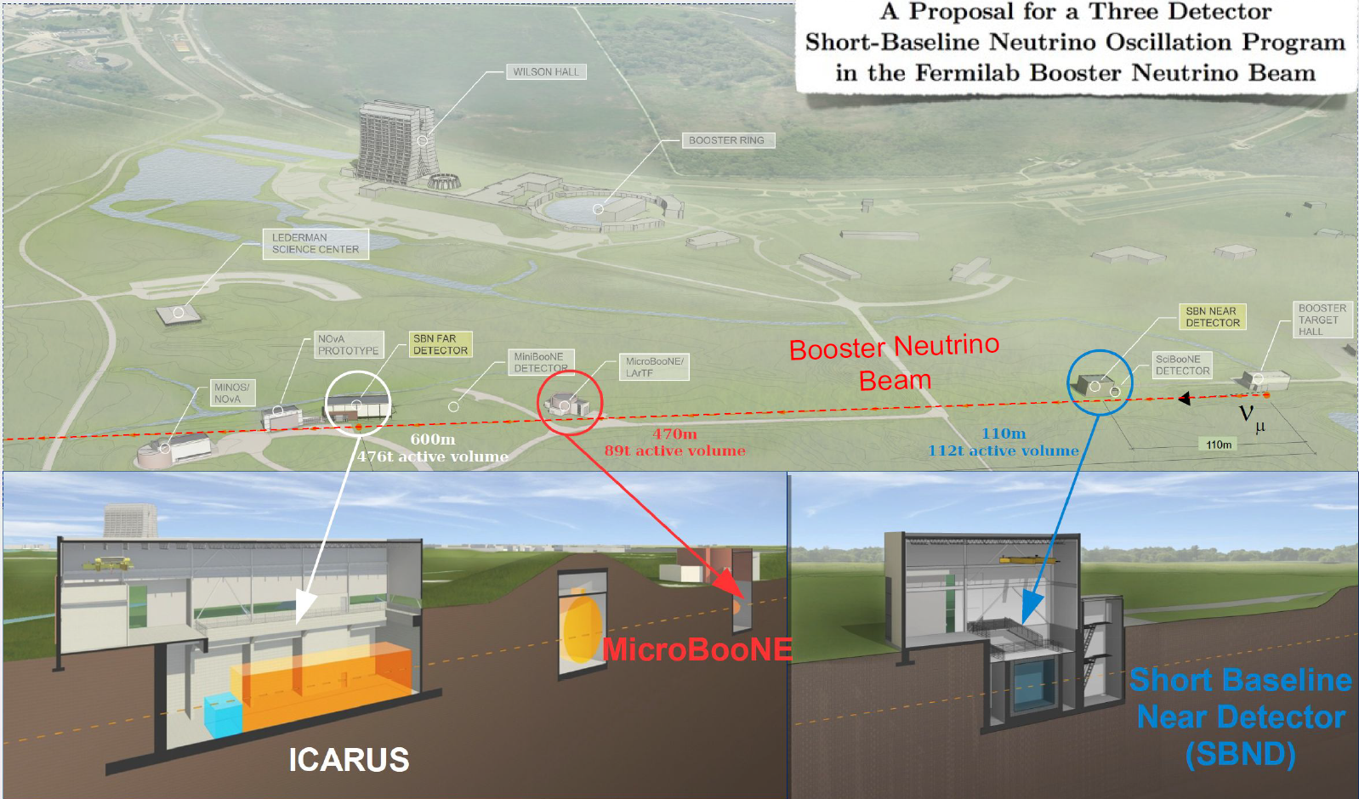
Short-Baseline Neutrino Program
Search for light sterile neutrino(s) through anomalous ν_{μ}→ν_{e} oscillation motivated by LSND and MiniBooNE anomalies

Slide 16
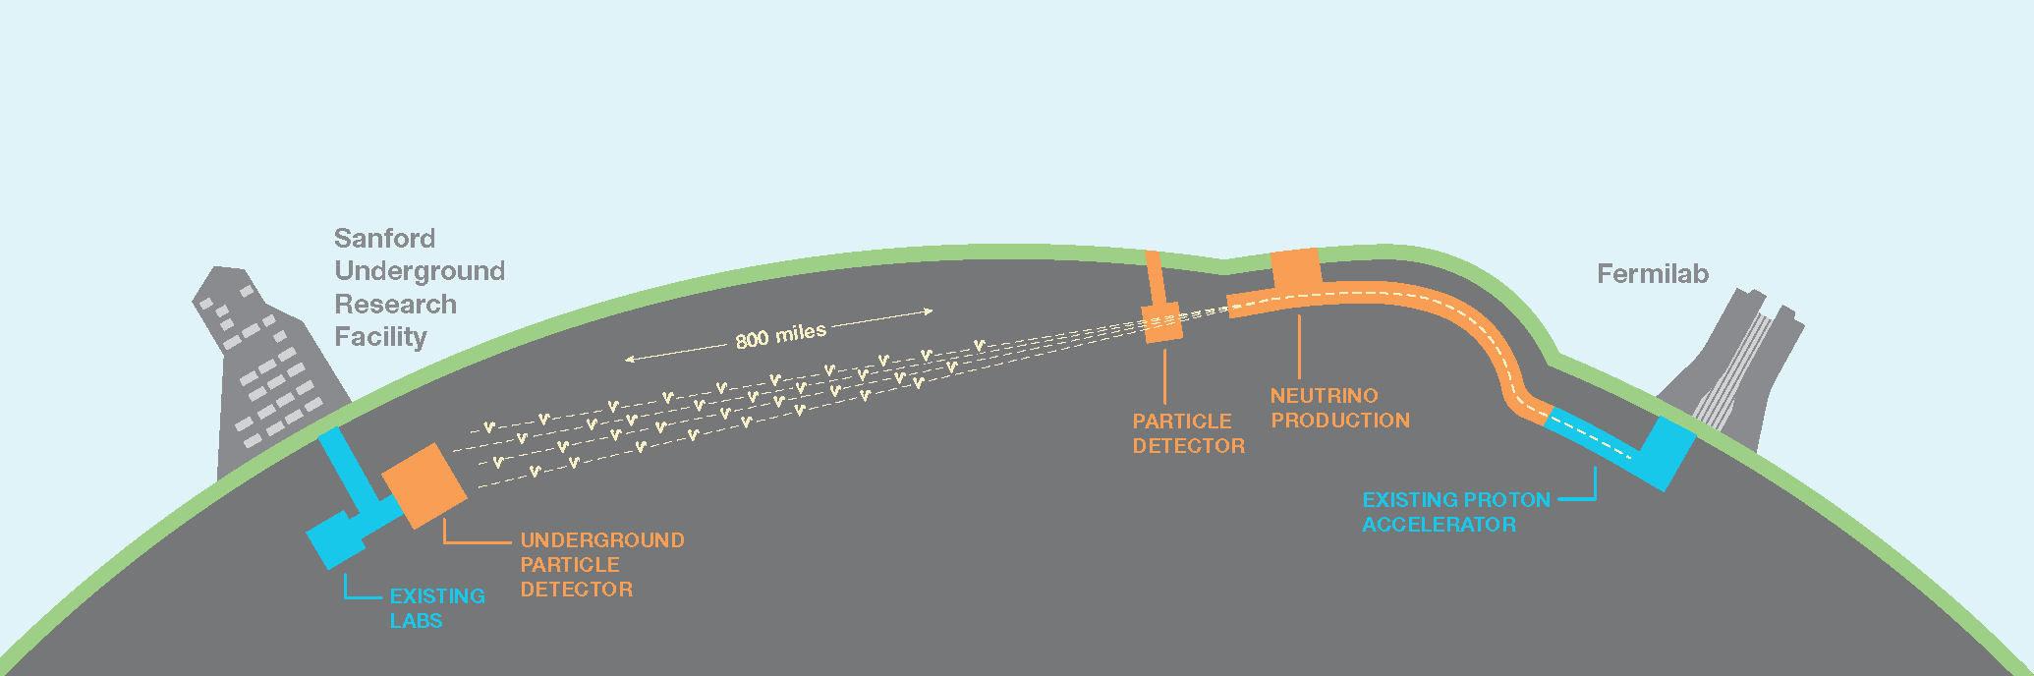
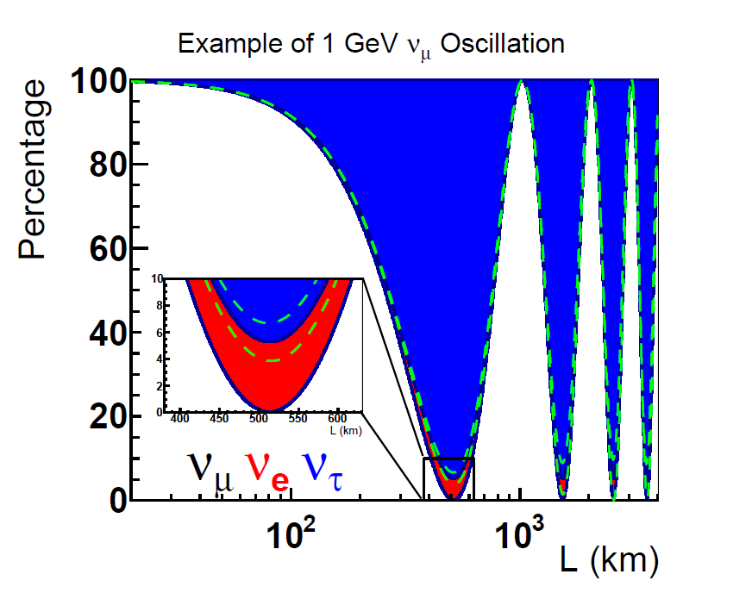
Deep Underground Neutrino Experiment (DUNE)
Search for new CP violation and determine the mass hierarchy through precision measurement of (anti)ν_{μ}→(anti)ν_{e} oscillation
Also search for proton decay and detection of supernova neutrinos

Slide 17
Path to 10s kT LArTPCs

Slide 18
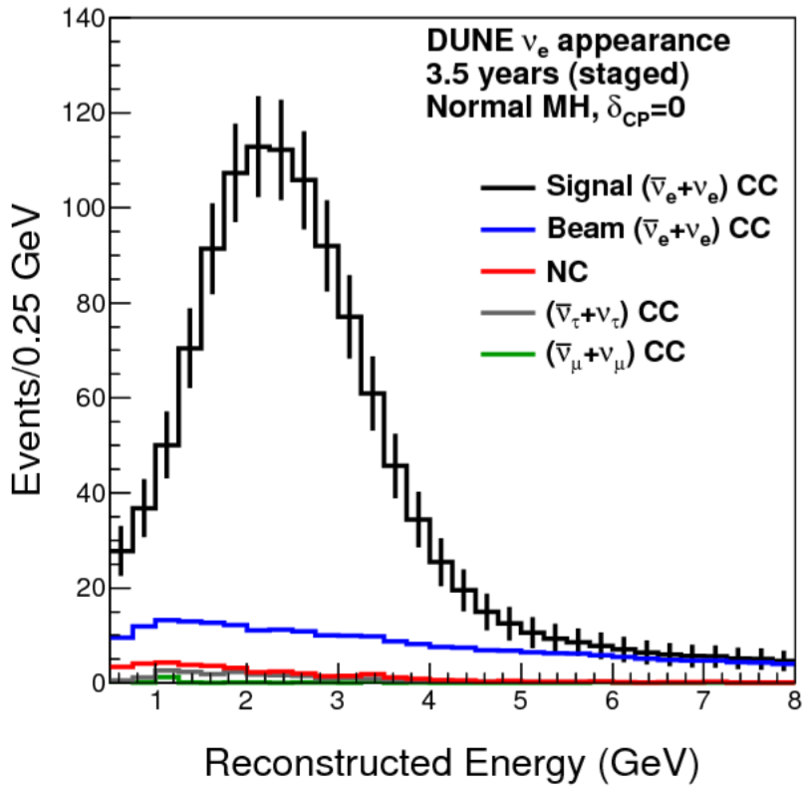
Why massive LArTPC?
O(1)% measurement → O(1000) events

Slide 19
Why massive LArTPC?

Slide 20
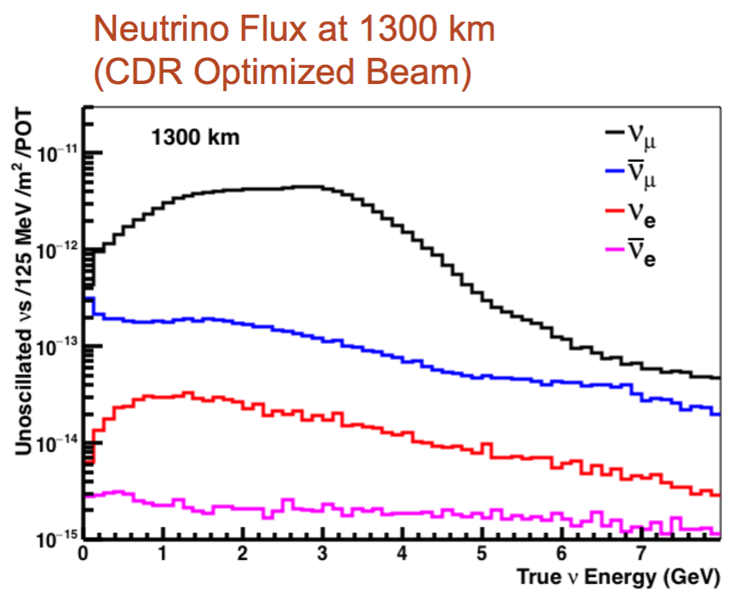
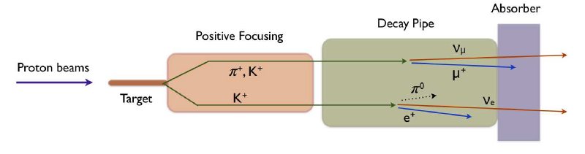
Why massive LArTPC?
Neutrino flux ~ 10¹⁷ /m²/10²⁰ (Proton On Target)
LBNF beam: 60-120 GeV proton beam 1.2 MW, upgradeable to 2.4 MW

Slide 21
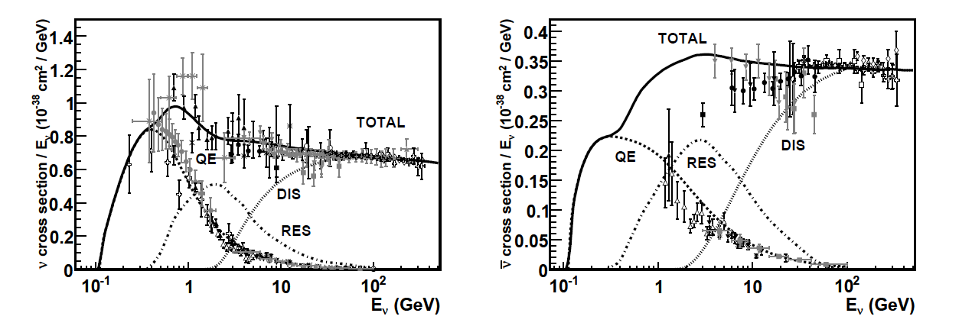
Why need massive LArTPC?
Neutrino cross section ~ 10⁻³⁸ cm² x Energy (GeV)
J. A. Formaggio and G. P. Zeller, Rev. Mod. Phys., 84:1307 (2012)

Slide 22
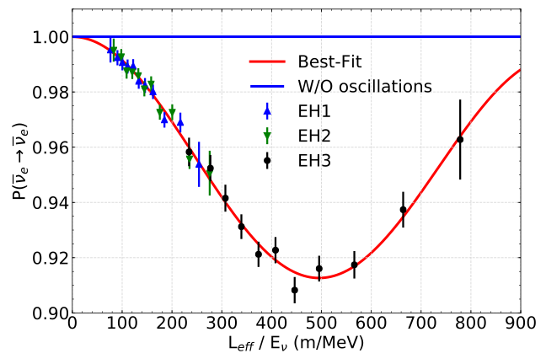
Why massive LArTPC?
ν Flavor Eigenstate
ν Mass Eigenstate
m₁
m₂
Neutrinos are produced and detected by the weak interaction, but propagate as mass eigenstates
Appearance
Survival
Neutrino oscillation in Daya Bay

Slide 23
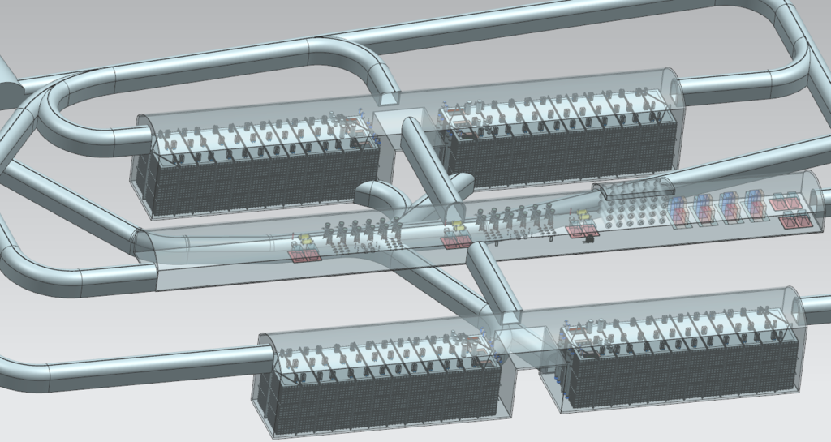
Why massive LArTPC?
Four 10 kT fiducial (17 kT total) LArTPCs 4850 feet underground
Neutrino interaction rate is approximately independent of neutrino energy and baseline
We need at least 10s kTons of target mass for O(1000) events

Slide 24
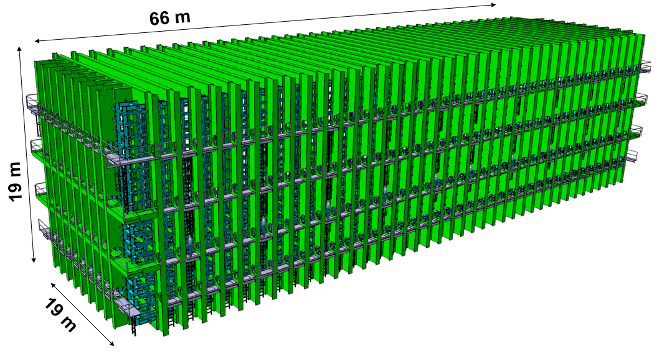
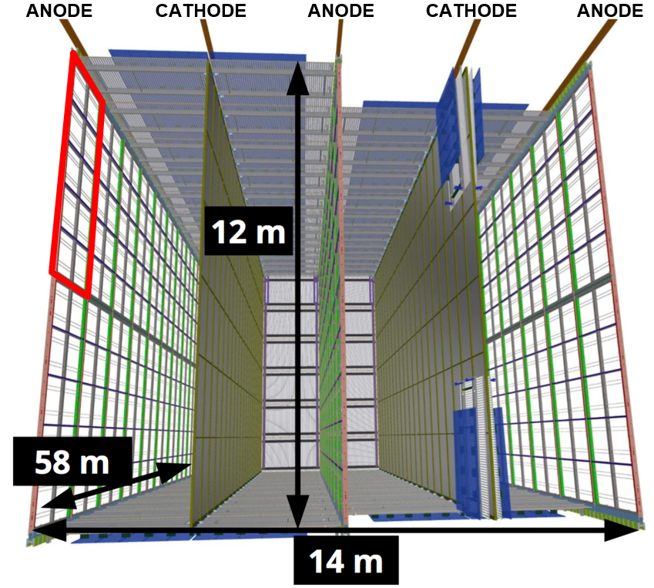
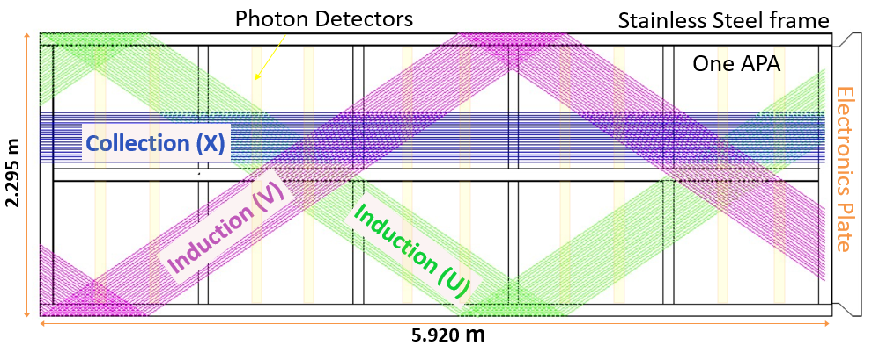
The First 10 kT Module of DUNE
Cryostat
150 APAs with 2560 readout channels each within three (1D) wire planes (~ 5 mm pitch)
Cost and power consumption of electronics in LAr
Anode Plane Assembly (APA)

Slide 25
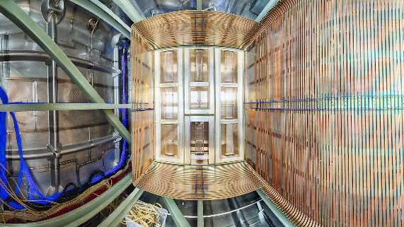
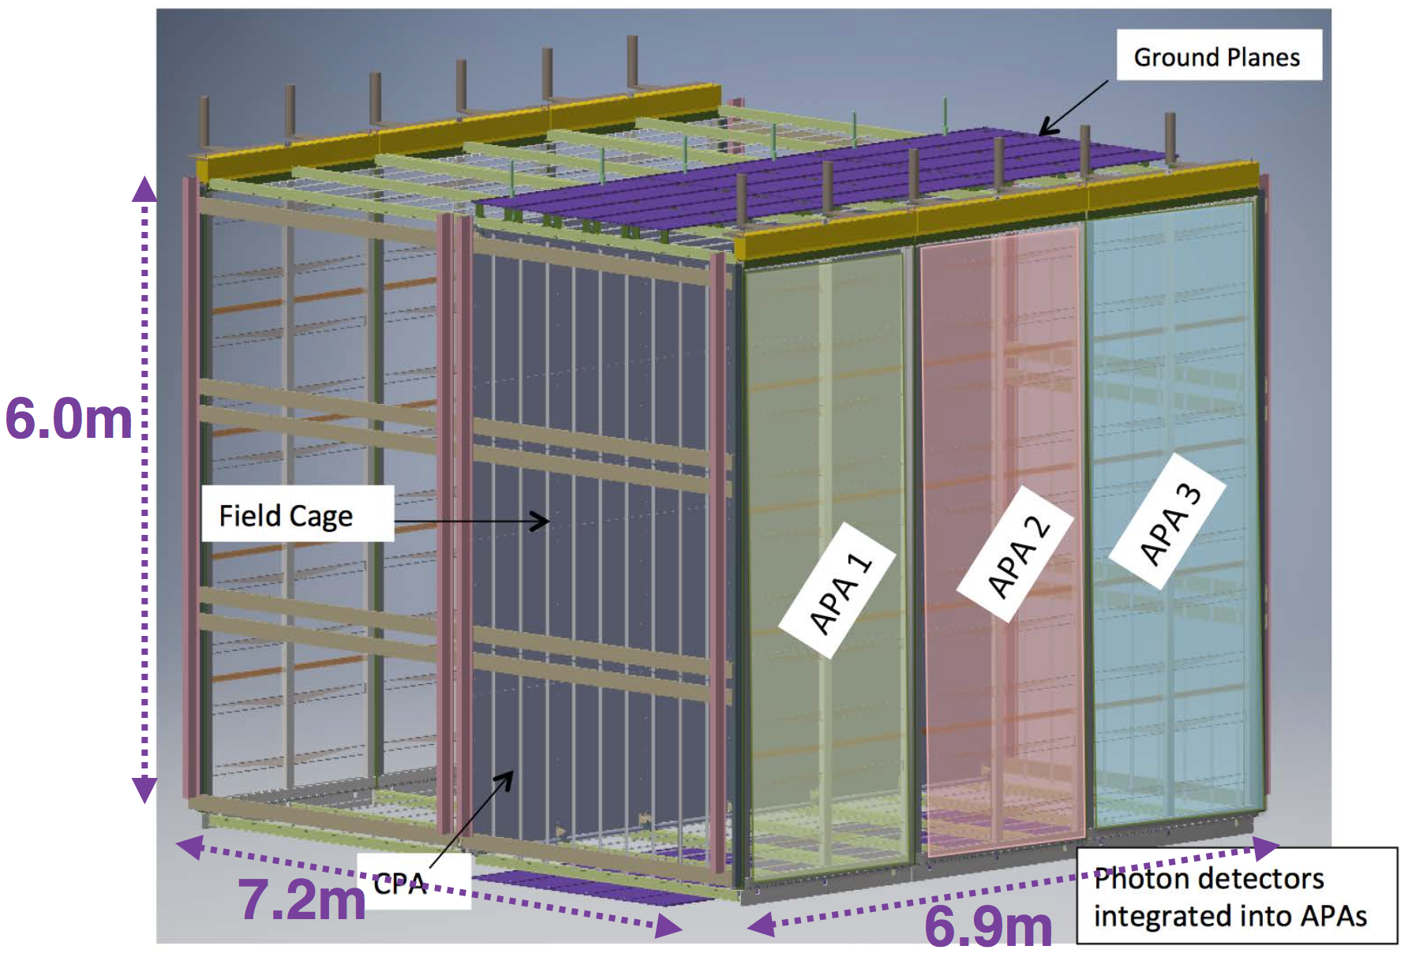
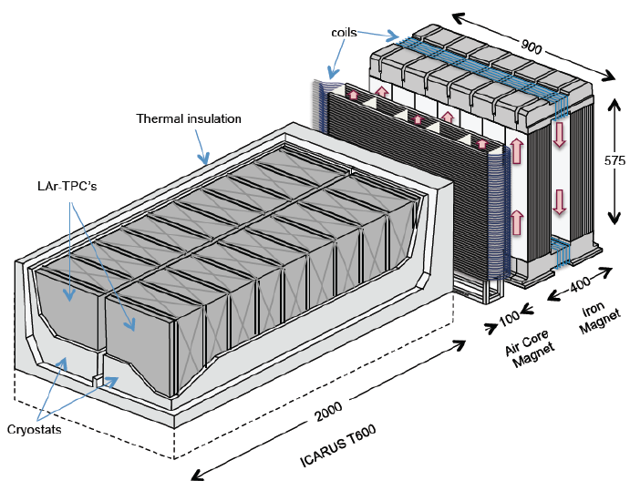
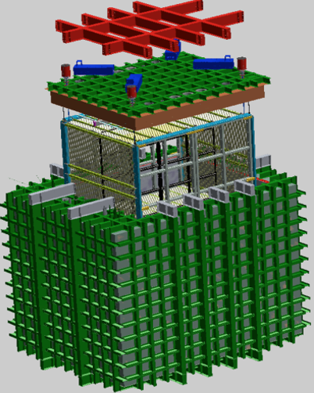
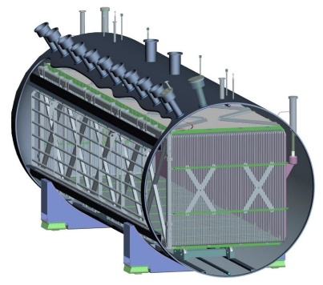
Path towards 10 kT Single-Phase LArTPCs
35-ton prototype
ProtoDUNE (NP04)
2001-2012
DUNE reference design
LBL
ICARUS
2014-2018
2018-2020
46 times larger than ICARUS
SBL
Also ArgonNeuT
Also development of dual-phase technology
MicroBooNE
SBND

Slide 26
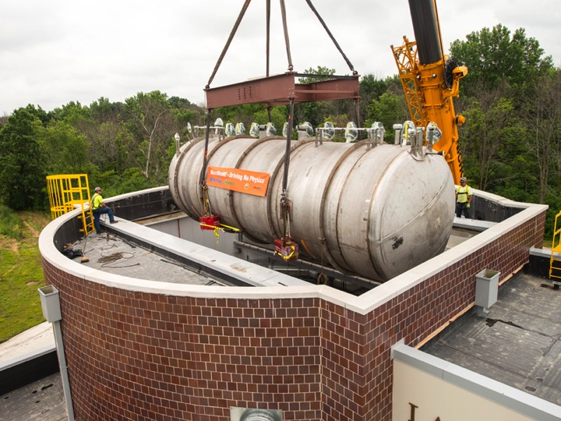
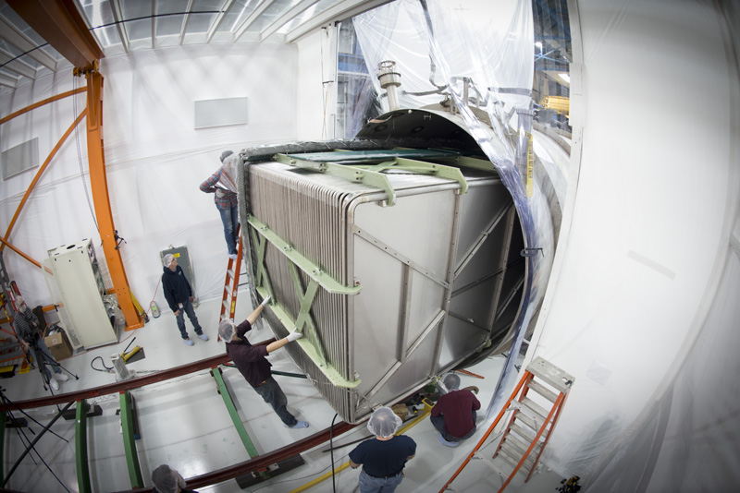
Technology Development in MicroBooNE
Physics motivation:
Understand the low-energy excess in MiniBooNE
Measure ν-Ar cross sections
Develop LArTPC technology

Slide 27
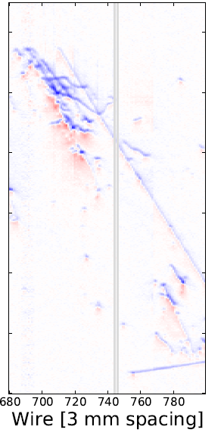
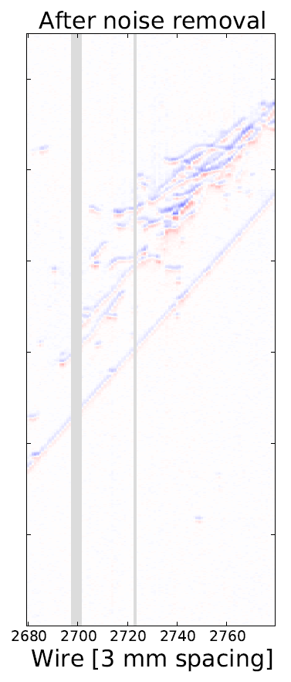
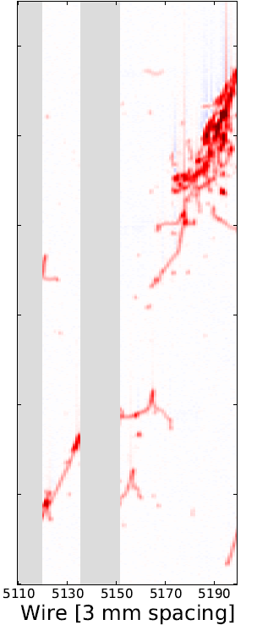

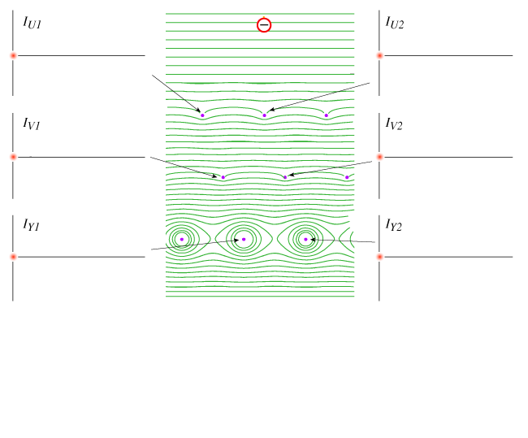
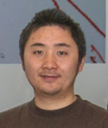
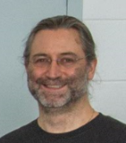
TPC Signal Formation
Induction U bipolar shape
Induction V bipolar shape
Collection Y unipolar shape
Attenuation due to attachment
Energy deposition
Wire pitch
Recombination
Nature of induction (long-range, position-dependent, following superposition principle) → smaller induction plane signals
Bo Yu
Small ionization signal in LAr → multiple wire planes with non-destructive induction readouts
Enabling technology: cold electronics
Yichen Li
Brett Viren

Slide 28
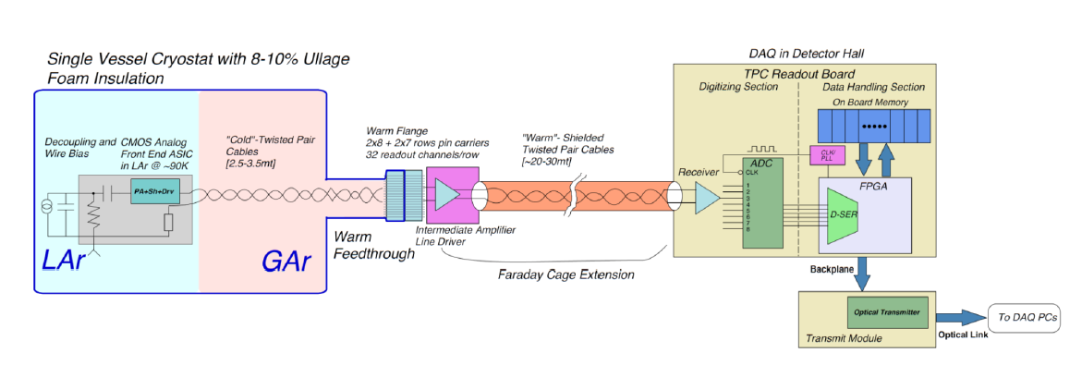
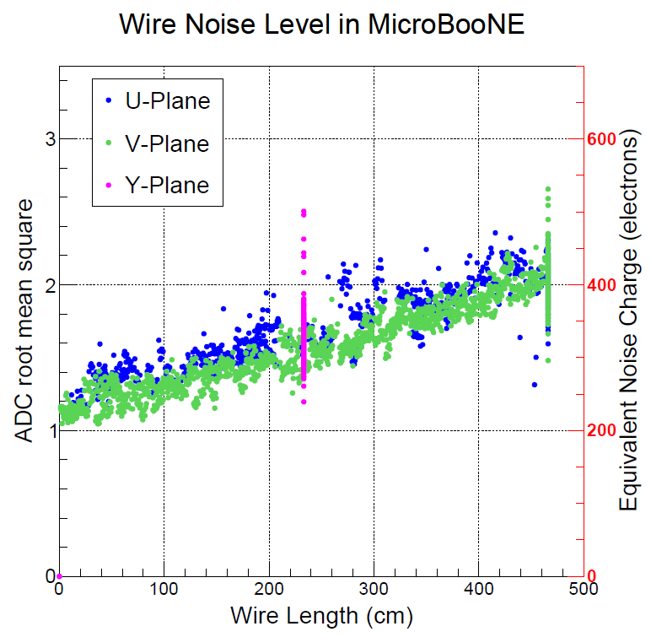
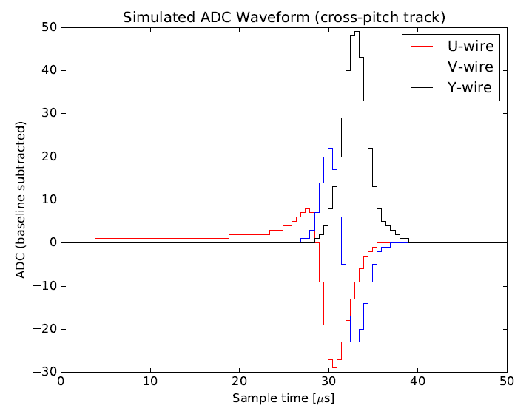
Cold Electronics
Placing the preamplifier inside LAr significantly reduced the electronics noise
5-6 times compared to past warm electronics → 60:1 MIP peak-to-noise ratio in the collection
Significantly improve the performance of induction wire plane → An enabling technology
1st International Workshop towards the Giant Liquid Argon Charge Imaging Experiment (2011)
JINST 12 P08003

Slide 29





Excess Noise Removal
Excess noise during initial phase caused by voltage regulator and HV power supply
Software mitigation
Identified noise sources and developed both hardware fix and software mitigation
JINST 12 P08003 (2017)
Jyoti Joshi
Brian Kirby
Mike Mooney
Notes:
Regulartor and HV power supply noise … 1 year

Slide 30





Improved Signal Processing: “2D Deconvolution”
Deconvolution technique with fast Fourier transformation (FFT)
O(N^{2.4~3}) → O(N logN) with N = 2400 (ch.) x 8256 (time) ~ 2x10⁷
Applied signal processing concepts to general data unfolding problem:
“Data Unfolding with Wiener-SVD Method”, W. Tang, X. Li, XQ, H. Wei, C. Zhang, JINST 12, P10002
Number of ionized electrons
Field Response
Drift Time
Signal on Wire Plane
Electronic Response
Signal to be digitized by ADC
(Signal Processing)
Number of ionized electrons
Wire number
JINST 13 P07006/7 (2018)
Wei Tang Xiaoyue Li
Hanyu Wei Brooke Russell

Slide 31
3D image reconstruction

Slide 32


Traditional Reconstruction Approach: 2D matching → 3D
2D pattern recognition
Matching to 3D objects
Error made in pattern recognition will propagate to the later reconstruction steps

Slide 33



Wire-Cell Tomographic Event Reconstruction
“Three-dimensional Imaging for Large LArTPCs”, XQ, C. Zhang, B. Viren, M. Diwan, JINST 13, P05032 (2018)

Slide 34


Solving: usage of Charge, Sparsity, Positivity, Connectivity
Brett Viren
Chao Zhang
The goal is to differentiate the true hits from fake ones by using the charge information
~ large charge → true hits ~ zero charge → fake hits
Sparsity, positivity, and connectivity information are added through compressed sensing (L1 regularization)
E. Candes, J. Romberg, T. Tao
arXiv-math/0503066

Slide 35


Demonstration of Charge Matching
Mike Mooney
Old 1D
Signal Processing
New 2D
Signal Processing
Brian Kirby
JINST, 13, P07007
Notes:
One set of plots … First time ever in LArTPC to reach charge matching …

Slide 36






Wire-Cell on the MicroBooNE Data
2015, after several hours of CPU running
Bee link
(upper) 1D deconvolution + L0 compressed sensing
2018, 3 mins of CPU running
Bee link
(lower) 2D deconvolution + L1 regularization
JINST 13, P05032 (2018)
Notes:
Significant improvement in SP and … write something … why is better ??? Remove last line, more dots → more hits, high efficiency …

Slide 37



Wire-Cell on MicroBooNE Data
Hanyu Wei Xiangpan Ji
A set of 3D clustering algorithms is developed based on data events
The damage of 10% dead channels can be sufficiently mitigated in the reconstruction

Slide 38
Neutrino Selection and Particle Identification

Slide 39



Challenge in Selecting Neutrinos
LArTPC is a slow detector, running on surface leads to significant challenges in selecting neutrinos
The key is to associate the correct T₀ (light info.) to the corresponding TPC cluster
Compressed Sensing with L1 regularization!
4.8 ms drift window
20-30 TPC activities

Slide 40




Before and After L1 Matching
Side view
Top view
Brooke Russell
Chao Zhang
Front view
Flash Observation
Prediction
Charge-Current ν_{μ} candidate
More details in MICROBOONE-NOTE-1040-PUB

Slide 41




Before and After L1 Matching
Side view
Top view
Brooke Russell
Chao Zhang
Front view
Flash Observation
Prediction
CC ν_{e} candidate
Over 98% matching accuracy evaluated with cosmic muons

Slide 42




Current Focus: Development of Particle Identification
Wenqiang Gu
Preliminary
London Cooper-Troendle
Development of precision PID with dE/dx information is critical for LArTPC technology

Slide 43


Stay tuned for physics results from MicroBooNE!
MicroBooNE: 70 Ton
ProtoDUNE: ~ 420 Ton

Slide 44

ProtoDUNE @ CERN
Prototype of DUNE with six APAs → validating design, prototyping production/installation procedure, demonstrating long-term operation stability
Test beam + cosmic data → detector response + cross section measurements

Slide 45



APA and Cold Electronics
< 1% dead channels combining wires and electronics
ENC < 750 e as expected without software noise filtering
Maura Spanu’s particle physics seminar this Thursday
Major success of the BNL electronics team!

Slide 46

The Enabling Technology for Giant LArTPCs: Cold Electronics
DUNE with warm electronics (300K)
ENC~6x10^3 e rms
MIP Signal for 5x5 mm Sense Wire Spacing
ProtoDUNE (89 K)
ENC~750 e rms
CMOS at 77K: ENC< 10³ e rms

Slide 47

7 GeV beam proton
7 m

Slide 48

Made by Chao Zhang (BNL)

Slide 49



History of Large Liquid Scintillator Detector
1950s
Reines & Cowan
Discovery of ν
Year | Experiment | Goal
1950s-1970s | Reines & Cowan | Search for νs
1980s-1990s | Bugey, Reines and co., Gosgen … (~28 experiments) | Search for ν oscillation at L<100 m
1990s-2000s | CHOOZ and Palo Verde | Measurement of θ₁₃ L ~ 1 km
2000s | KamLAND | Measurement of Δm²₂₁ L~ 180 km
2010s | Daya Bay/ RENO/ Double Chooz | Measurement of θ₁₃ L~ 2 km
2018 | NEOS/DANSS/PROSPECT/STEREO … | Search for sterile ν at O(10) m
2000s
KamLAND
Solving solar ν problem on Earth
2010s
Daya Bay
Discovery of non-zero θ₁₃
Petr Vogel arXiv:1902.03281 and also review on “Physics with Reactor Neutrinos”, XQ, J. C. Peng Rept. Prog. Phys. 82, 036201 (2019)

Slide 50



Noise Filtering &
ADC Mitigation
TPC Signal Processing
3D Image Reconstruction
3D Clustering
Track/shower separation, PID & Event ID
3D Pattern Recognition
Trajectory fitting and dE/dx reco.
TPC/PMT flash matching
Neutrino Energy Reconstruction
LEE and Cross section analyses
Summary
LArTPC is a crucial detector technology to answer many remaining questions in neutrino physics
The development of LArTPC technology is building a solid foundation for next discoveries with neutrino oscillation in coming decades
DUNE FD, SP
ProtoDUNE SP
MicroBooNE
SBND

Slide 51

Thanks for your attention

Slide 53




Signals from a Track Segment

Slide 54
Matrix Inversion and Deconvolution
Tensor R is Toeplitz
Response only depends on the relative positions between signal and measurement
(R^{T}R)⁻¹ can be achieved through the deconvolution technique with fast Fourier transformation (FFT)
O(N^{2.4~3}) → O(N logN)
One of top 10 algs. in 20th century
Immense dimension of M and S: 2400 (chs.) x 8256 (time bins) ~ 2 x 10⁷
Extreme challenge in matrix inversion!
1D deconvolution SP in LArTPC described in B. Baller JINST 12, P07010

Slide 55


Deconvolution Technique
Time domain
Fourier transformation
Frequency domain
Back to time domain
Inverse Fourier transformation
Wiener filter: optimized by power of signal and noise in freq. domain
N. Wiener (1964)
Example taken from X. Li et al. JINST 12, P10002
Also PMT SP in Daya Bay: NIMA, 895, 48

Slide 56

2D Deconvolution
Measured waveform
1-D deconvolution
2-D deconvolution
R₁ represents the induced signal from (i+1)th wire signal to ith wire
The inversion of matrix R can again be done with deconvolution → 2-D Fast Fourier Transformation
JINST 13 P07006/7 (2018)

Slide 57


Signal Processing Evaluation
Quantitative evaluation of the signal processing chain → inefficiency for prolonged tracks (large-angle) track
4-wire plane proposal for DUNE
JINST, 13, P07006

Slide 58


Calibration of Electronics Response
Observed imperfect response due to “imperfect pole cancellation”
Significantly reduced in the newer generation of ASICs
Developed a procedure to calibrate out imperfect electronics response
Being applied to protoDUNE for ADC nonlinearity calibration
SP part II: JINST, 13, P07007
Led by BNL in collaboration with CSU
Notes:
Get rid of this one

Slide 59



L1 Signal Processing
L1 (compressed sensing) → a good solution to the signal processing in the V-Y shorted region
E. Candes, J. Romberg, T. Tao
arXiv-math/0503066
Thorough understanding of MicroBooNE detector achieved!
JINST, 13, P07007
Notes:
Math and computing (important technique developed, BNL brought in these for LArTPC PS and reconstruction), underdetermined system

Slide 60
SP for shorted-Y region
L1 (compressed sensing) became a good solution to the signal processing in the V-Y shorted region
Powerful new technique first introduced in LArTPC by BNL group
Thorough understanding of MicroBooNE detector achieved!
JINST, 13, P07007
Notes:
Math and computing (important technique developed, BNL brought in these for LArTPC PS and reconstruction), underdetermined system

Slide 61
Noise (ENC) vs TPC Sense Wire and Signal Cable Length for CMOS at 300K and 89K MIP Signal for 3x3 and 5x5 mm Sense Wire Spacing
DUNE with warm electronics (300K)
ENC~6x10^3 e rms
MicroBooNE
ENC~400 e rms
CMOS at 77K: ENC< 10³ e rms

Slide 62


Challenge in Selecting Neutrinos
4.8 ms drift window
Coin. with ν beam
20-30 TPC activities
40-50 PMT activities
LArTPC is a slow detector, running on surface leads to significant challenges in selecting neutrinos
The key is to associate the correct T₀ (light info.) to the corresponding TPC cluster
Compressed Sensing with L1 regularization!

